Slide 1
Regression
~Abhishek Kumar

Slide 2
Scope
What is regression?
Types of regression
Math in the Machine
Cost functions
Grdient Descent
Normal Equations
Assumptions
Pros and Cons

Slide 3
Regression
Supervised
Predciting real valued output/ continuous variables
In statistics, a measure of the relation between the mean value of one variable (e.g. output) and corresponding values of other variables

Slide 4
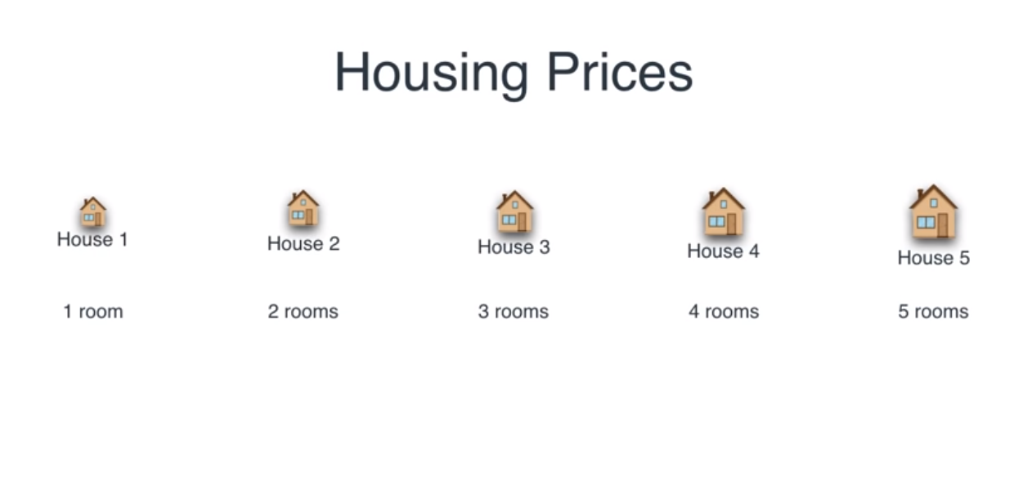

Slide 5
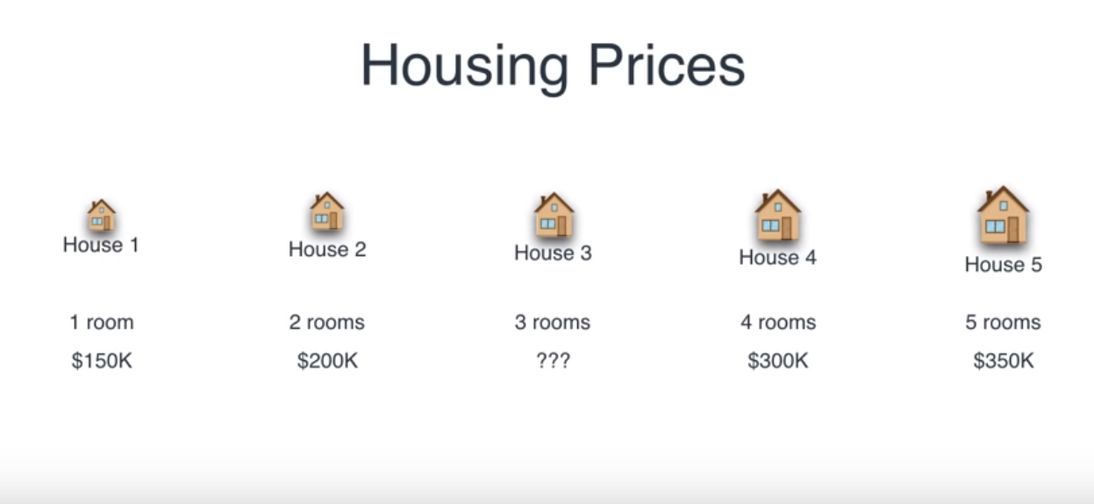

Slide 6
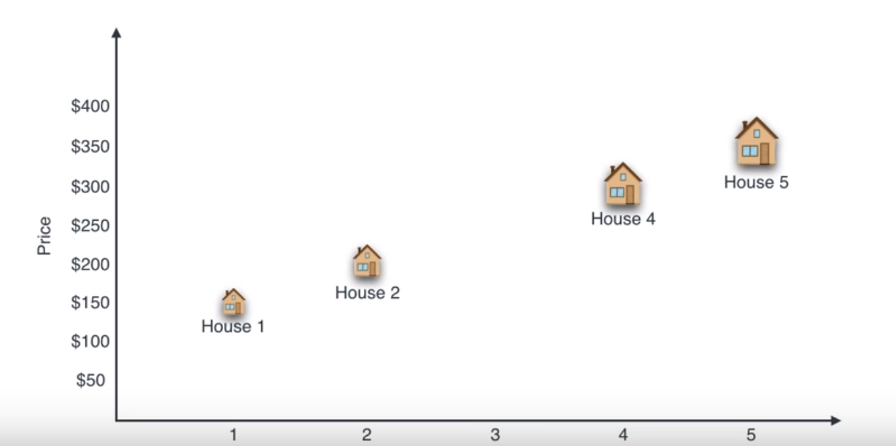

Slide 7
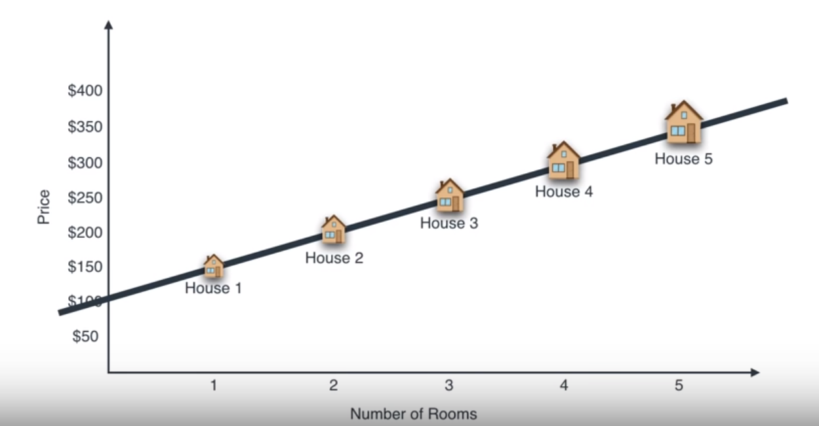

Slide 8
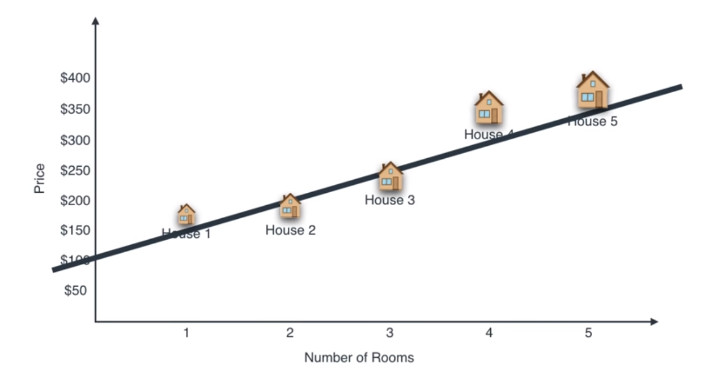

Slide 9
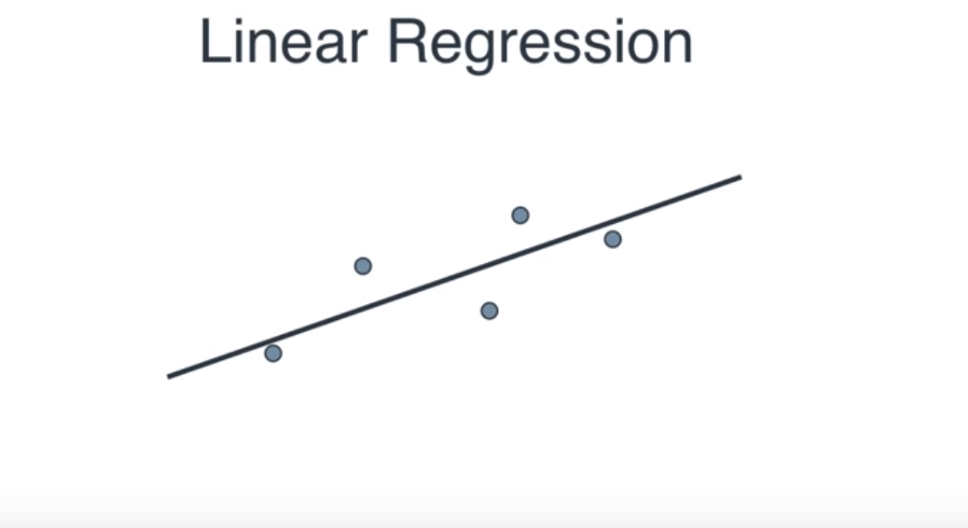

Slide 10
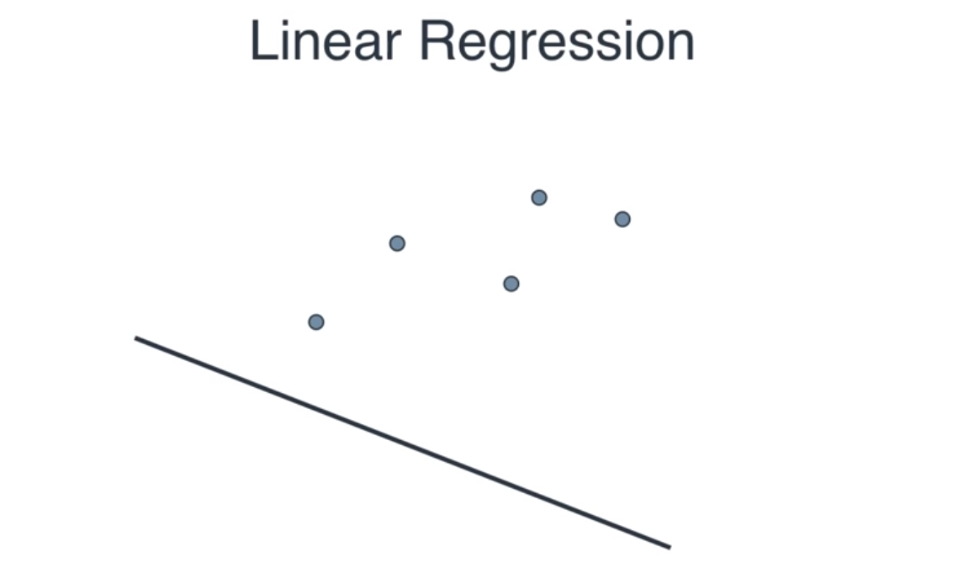

Slide 11
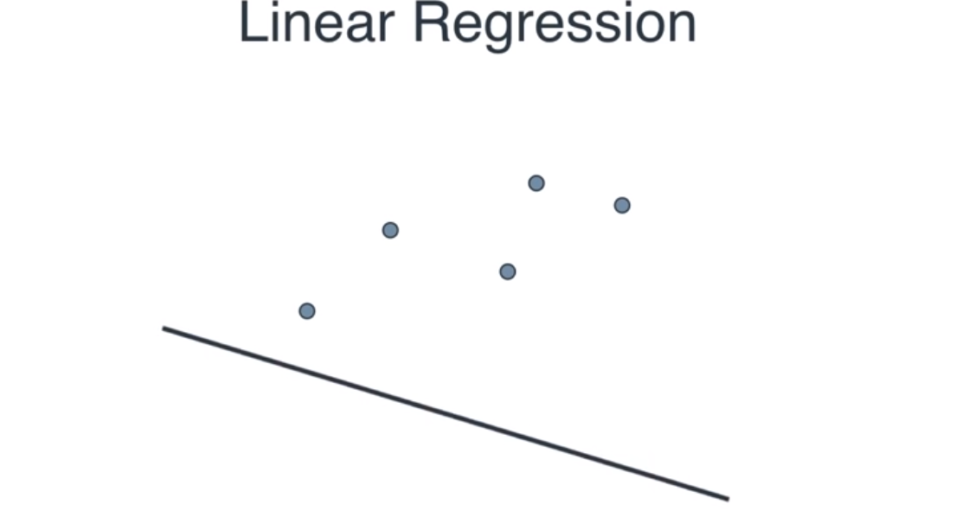

Slide 12
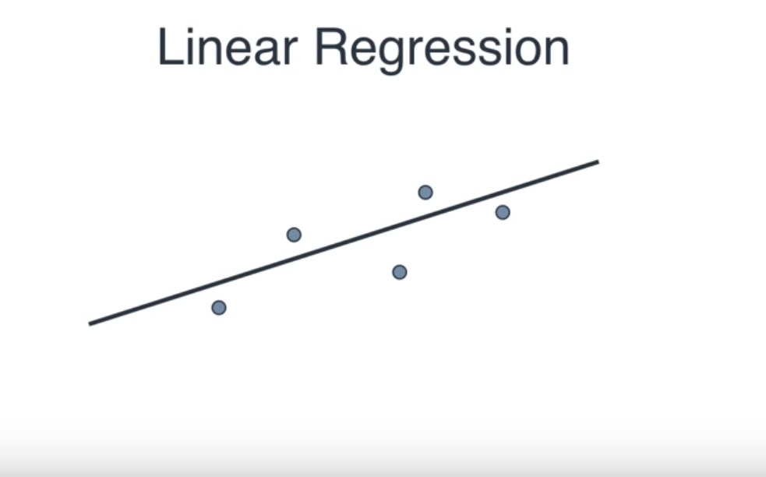

Slide 13
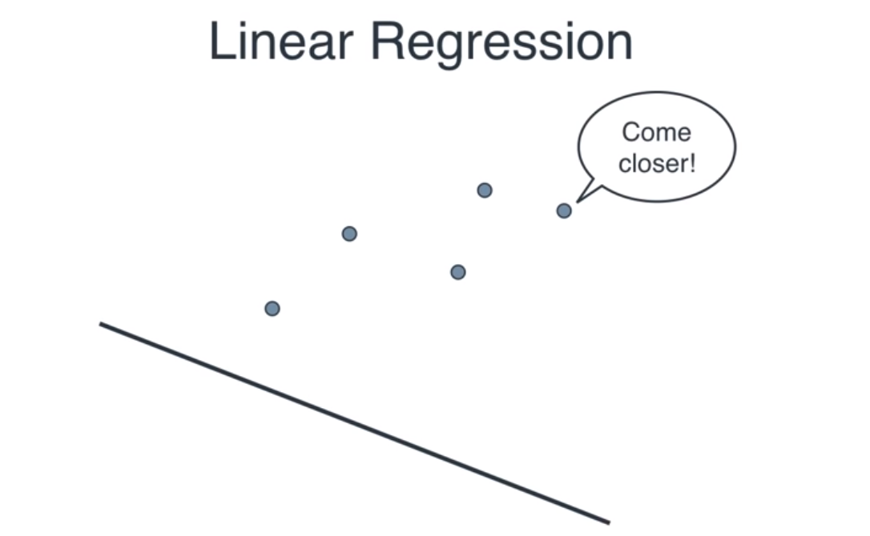

Slide 14
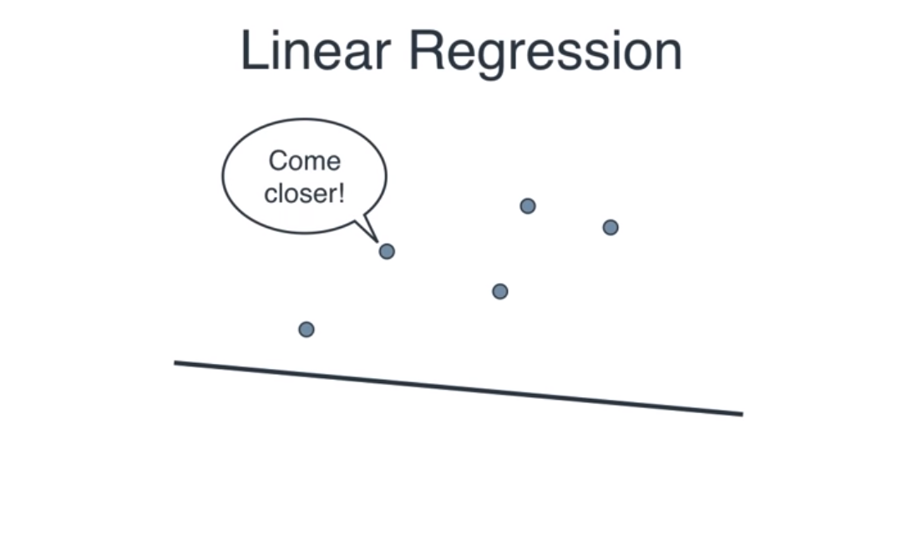

Slide 15
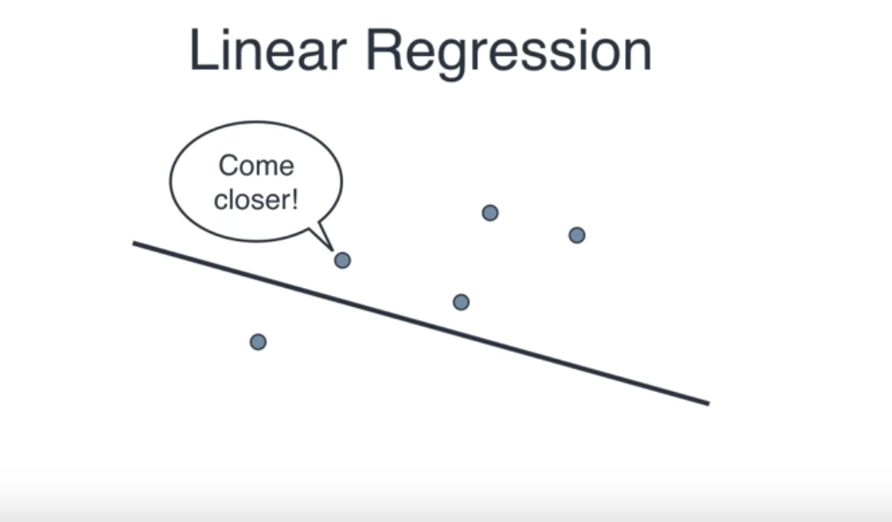

Slide 16
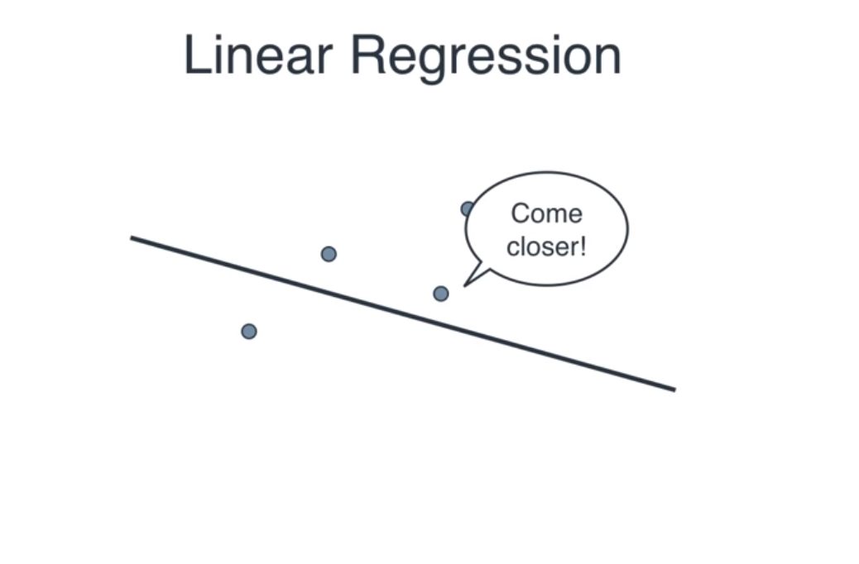

Slide 17
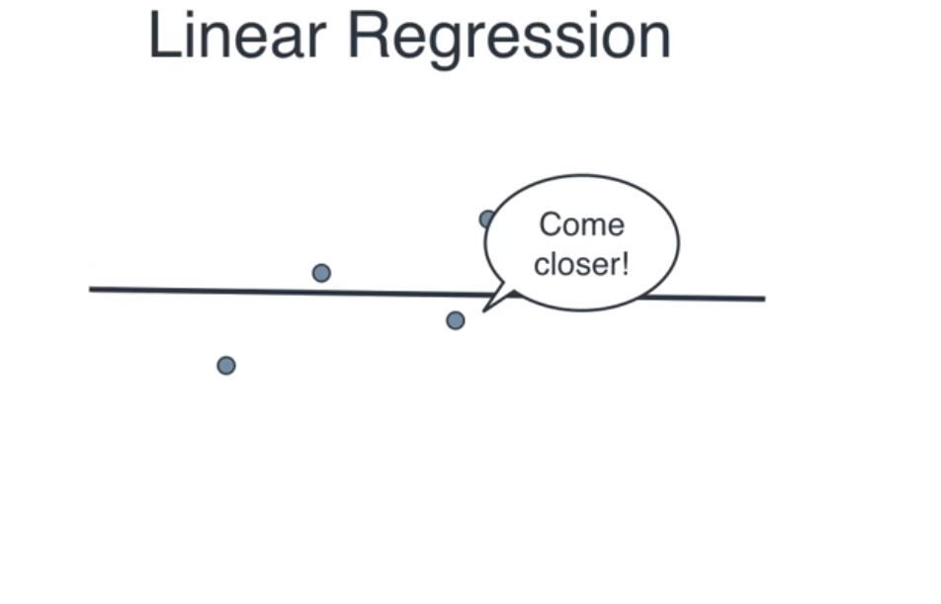

Slide 18
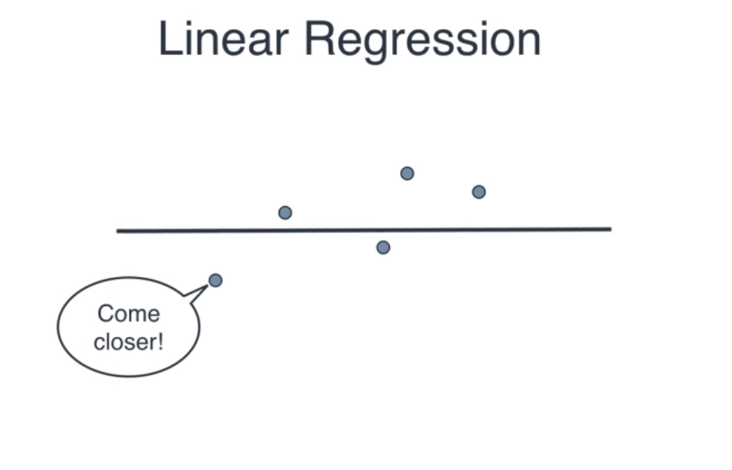

Slide 19
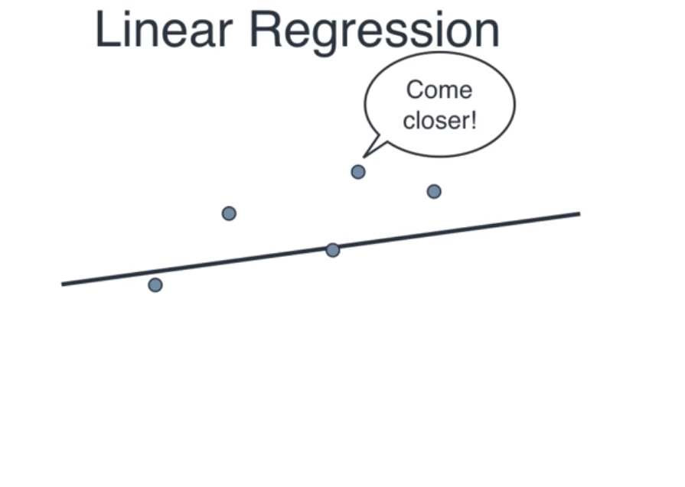

Slide 20
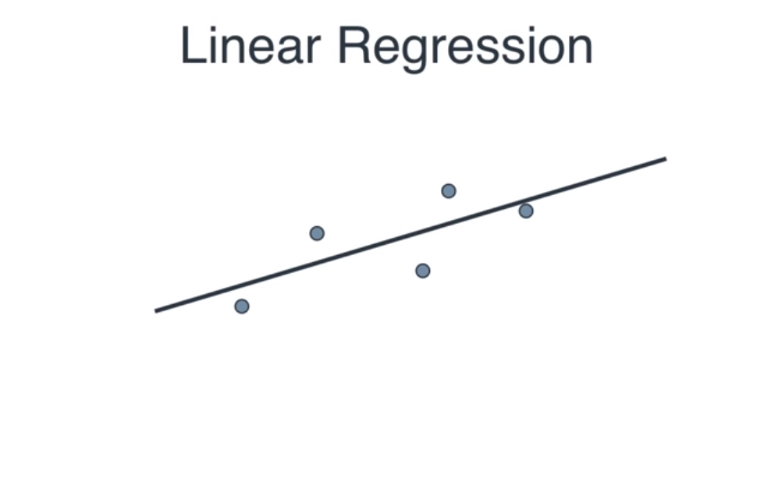

Slide 21
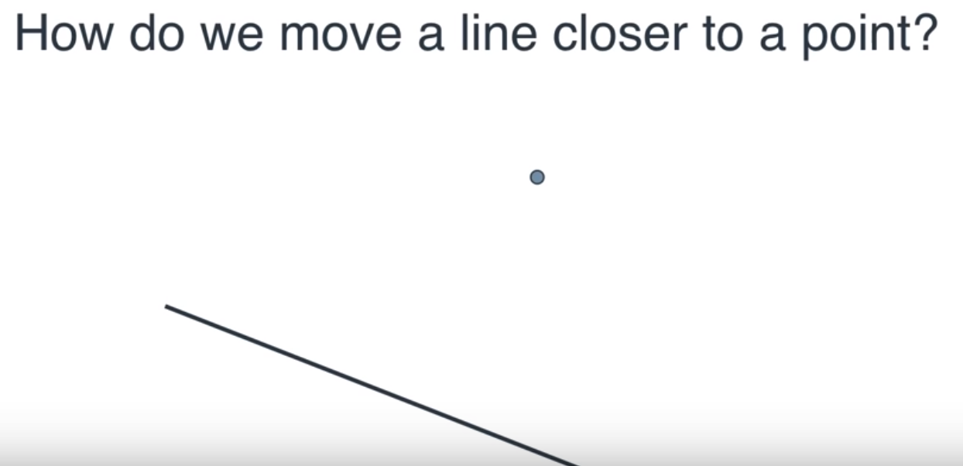

Slide 22
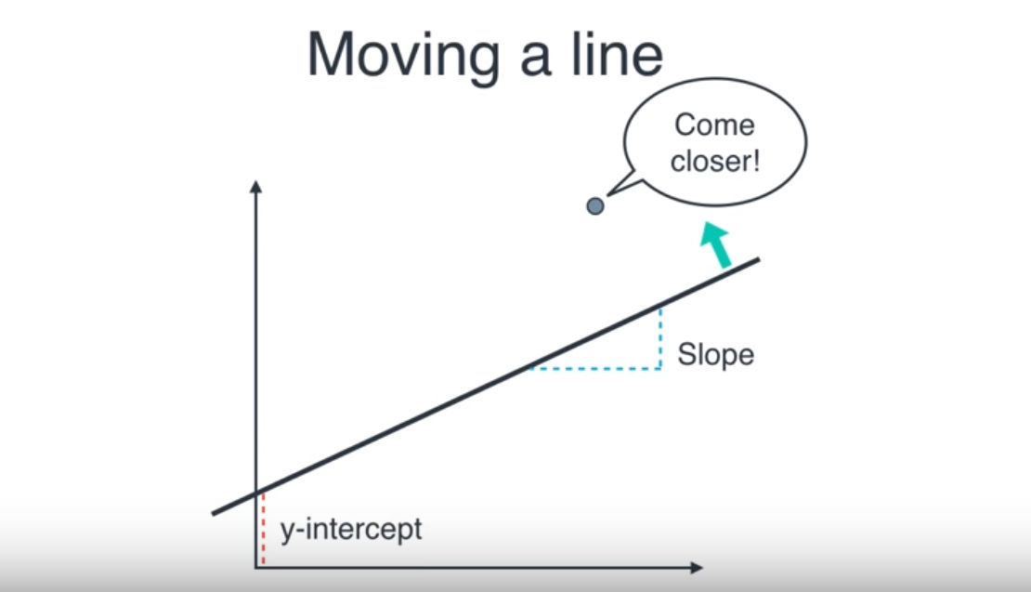

Slide 23
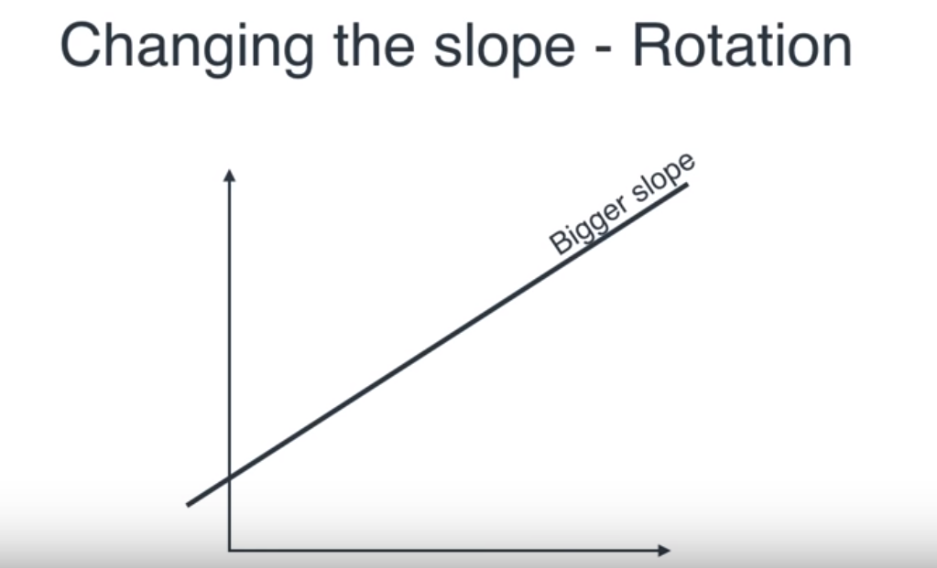

Slide 24
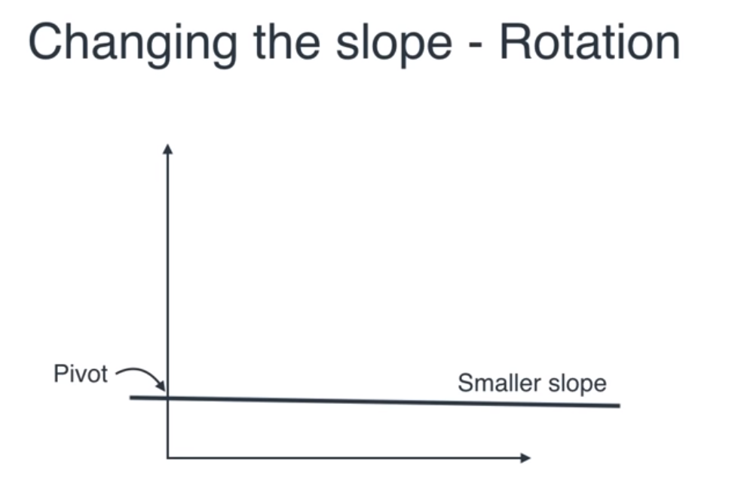

Slide 25
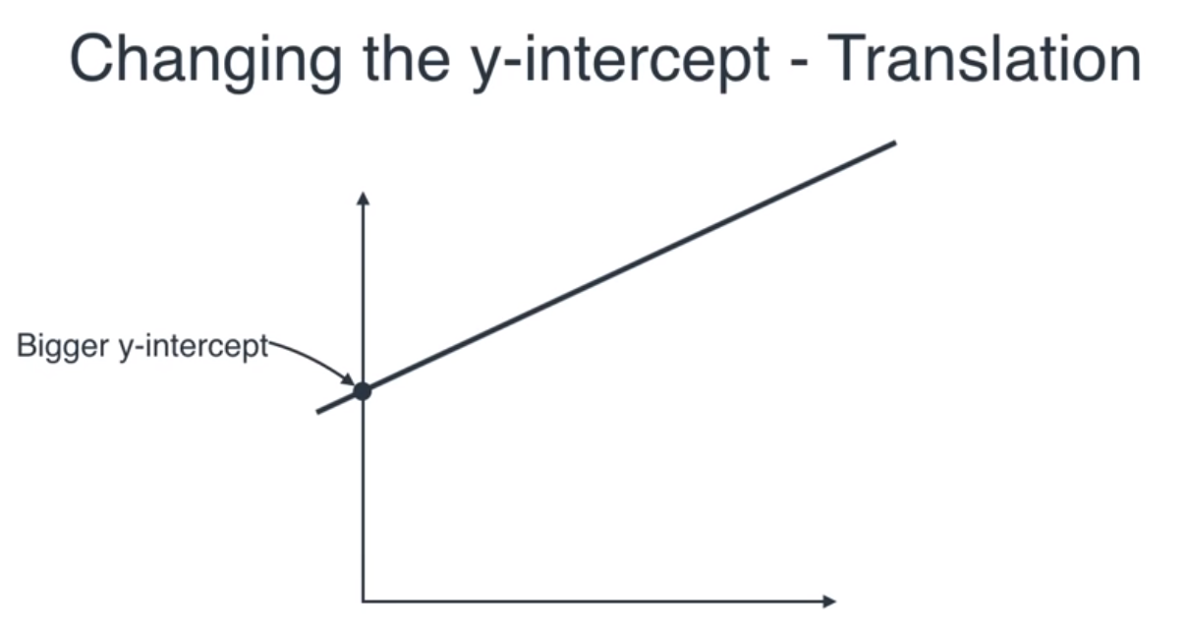

Slide 26
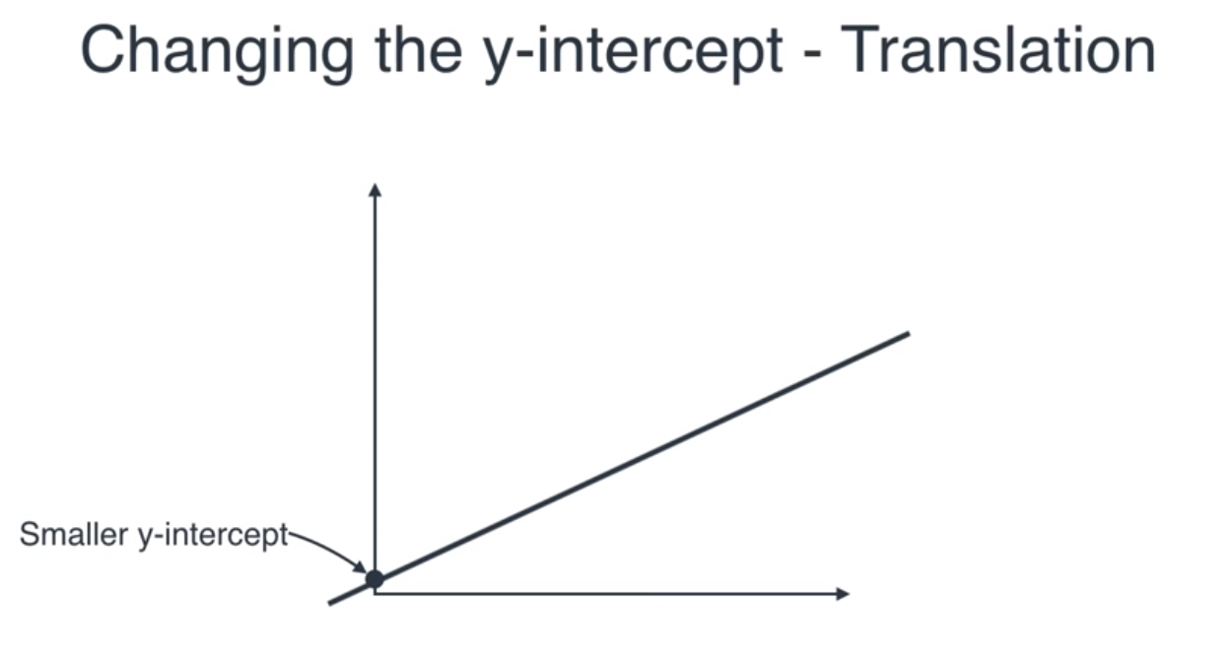

Slide 27
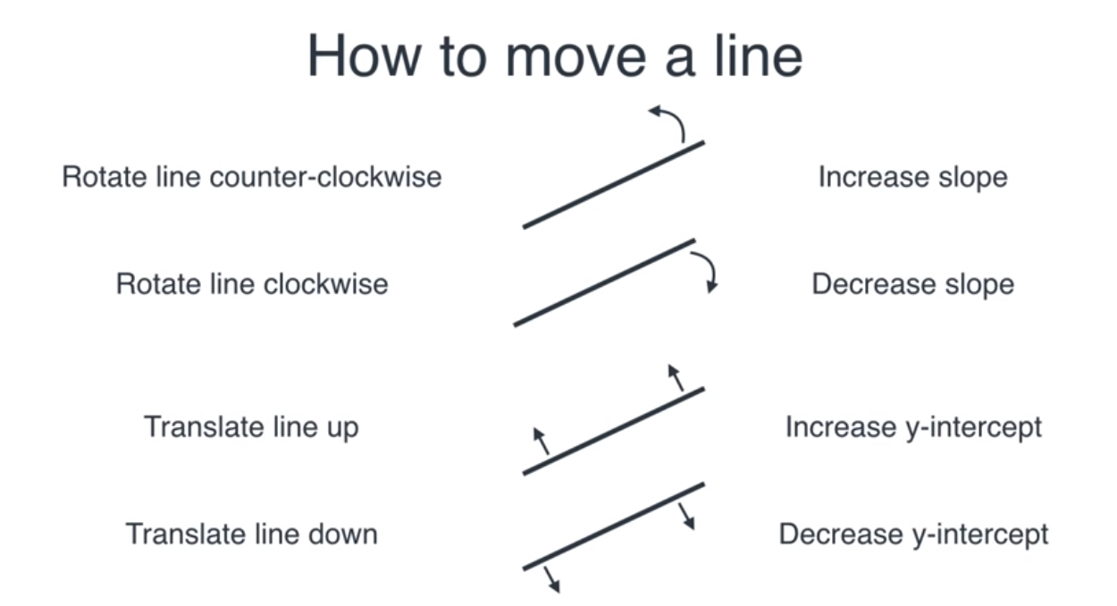

Slide 28
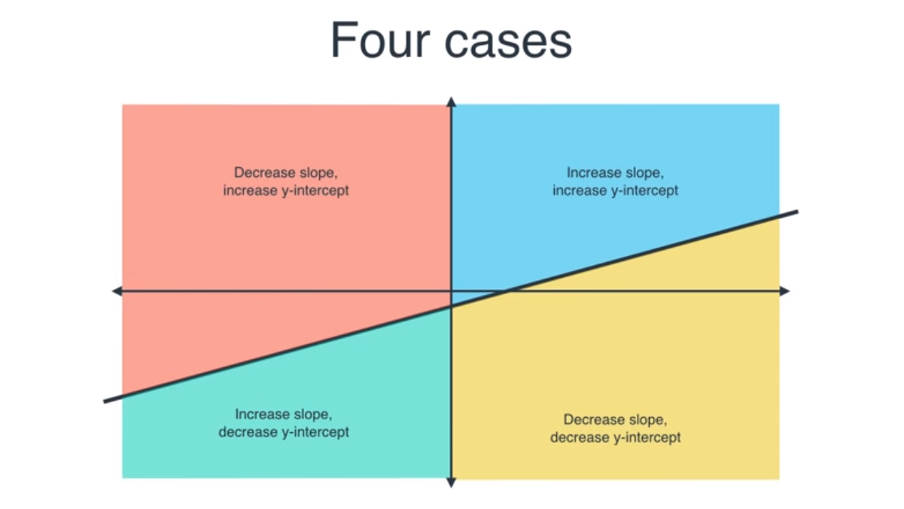

Slide 29
What are these errors actually mean?
Carguru

Slide 30

Math in Machine!!

Slide 31
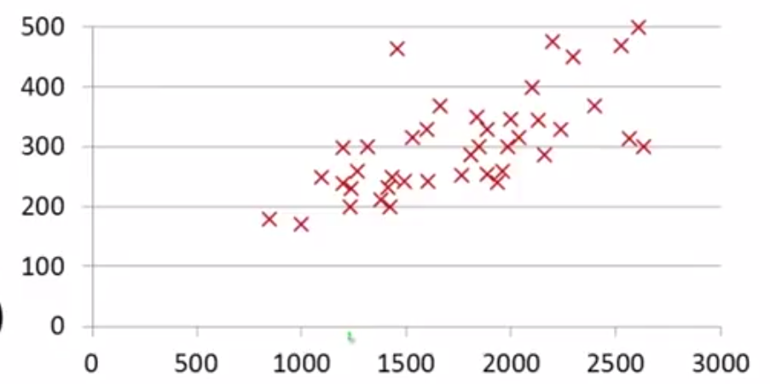
Price in $1000’s
Size (feet)²

Slide 32
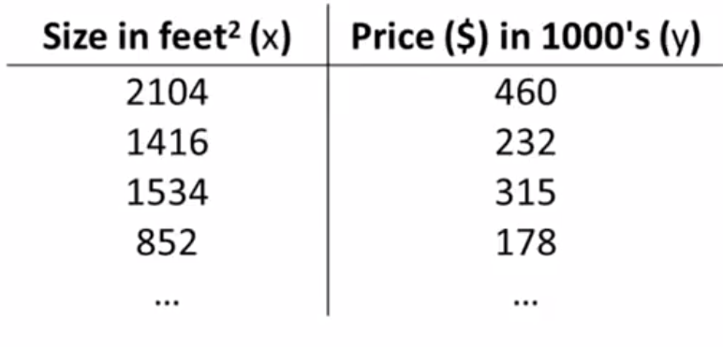
Notations
n = number of training examples
x’s = input variable/features
y’s = output variable/ “target” variable
(x,y) = one training example
(x^{(i)} , y^{(i)}) = i^{th} training example

Slide 33
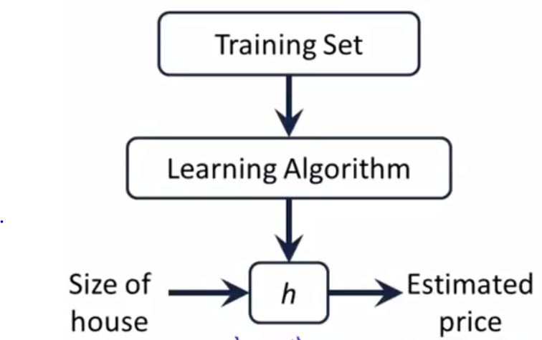
h maps from x’s to y’s

Slide 34
How do we represent h?
h(x) = mx+c
Linear Regression with one variable
/Univariate Regression

Slide 35
How do we know that this line is the best fit?

Slide 36
Univariate Regression COST FUNCTION!
Help us to figure out how to best fit the line to our data
Hypothesis: h(x) = mx+c
m,c = parameters of the model
How to choose m, c ?

Slide 37
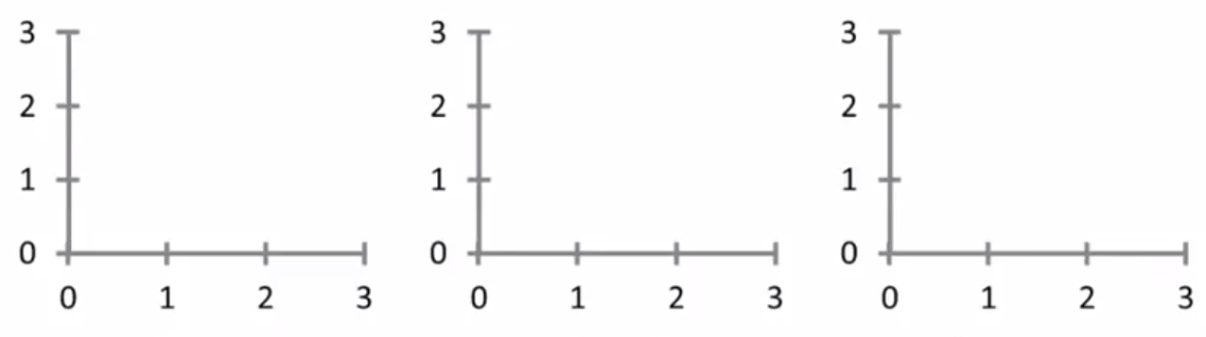
c = 1.5
m = 0
c = 0
m = 0.5
c = 1
m = 0.5
h(x) = mx+c

Slide 38
asdad
Idea; Choose m, c so that h(x) is close to y for our training examples (x,y)

Slide 39
Squared Error Cost Function

Slide 40
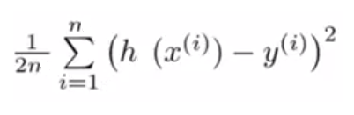
Recap!
Hypothesis: h(x) = mx +c
Parameters = m , c
Cost function: J (c,m) =
Goal = minimize J (c,m)

Slide 41
C = 0 (simplied version)
h(x) for fixed m is the function of x
J(m) is a function of m
m = 1, J = ?
m = 0.5, J = ?
m = 0, J = ? What is optimal value of m?

Slide 42
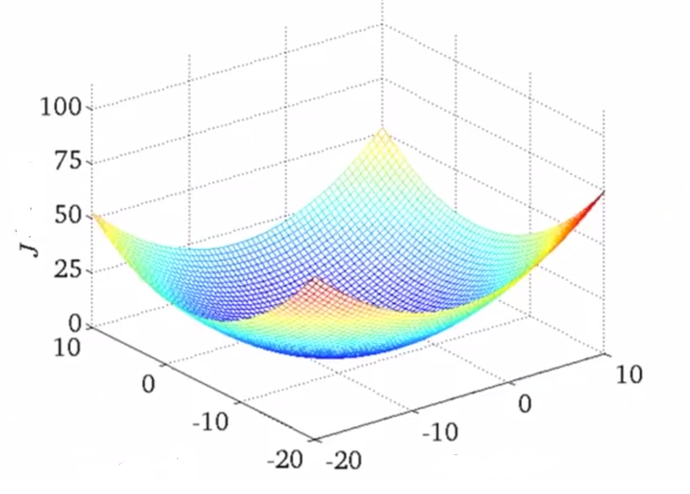
For c,m
c m

Slide 43
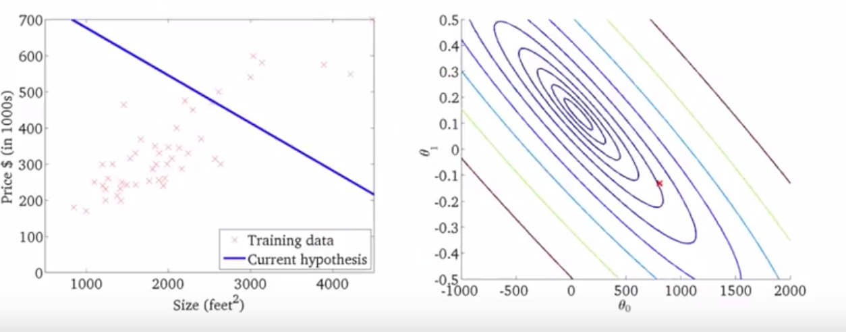

Slide 44
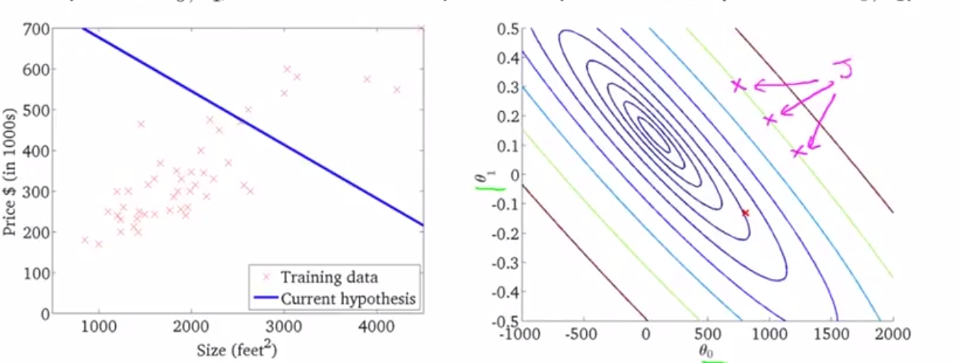

Slide 45
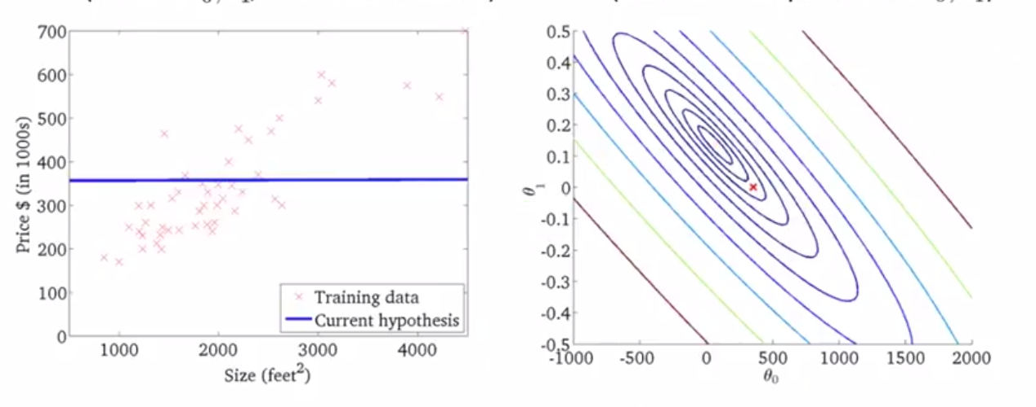

Slide 46
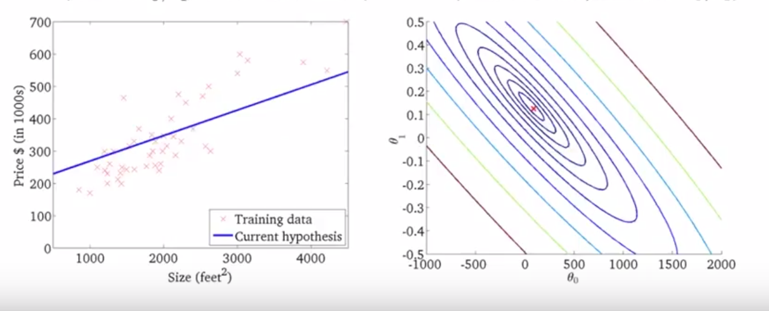
SSE is minimum in this case

Slide 47
What do we need now?
We need some efficient algorithm which automatically find out best value of m,c which minimize the cost finction J

Slide 48
Gradient Descent
Used for minimizing cost function.
Have some function J(c,m)
Want min J(c,m)
Outline
Start with some c,m
Keep changing c, m to reduce J(c,m) until we hopefully end at a minimum.

Slide 49
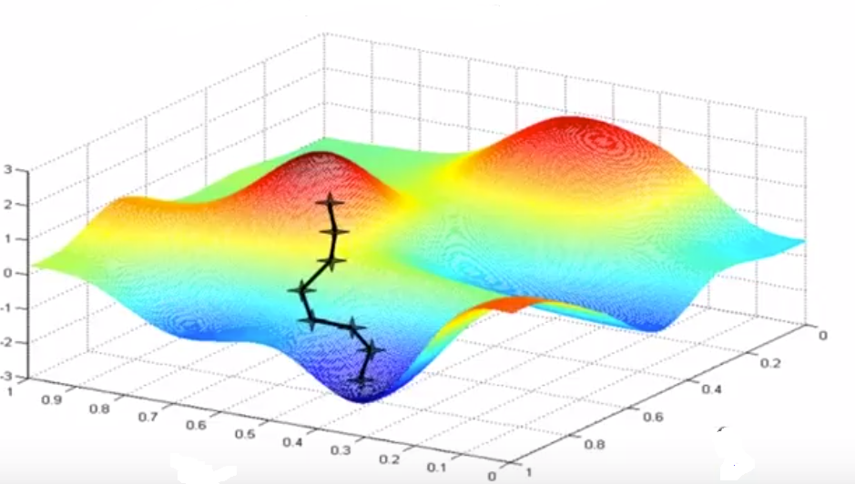
https://www.youtube.com/watch?v=vWFjqgb-ylQ

Slide 50
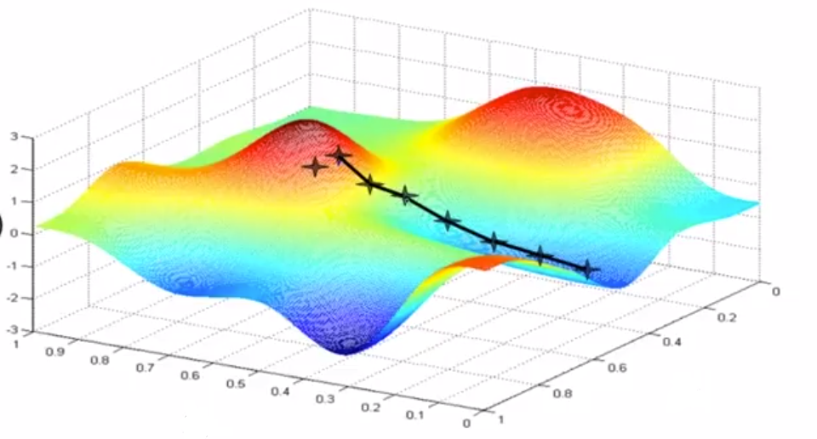

Slide 51
Learning rate (alpha)
If alpha is too small, gradient descent can be slow.
If alpha is too large, gradient descent can overshoot the minimum. It may fail to converge or even diverge.
(show example)

Slide 52
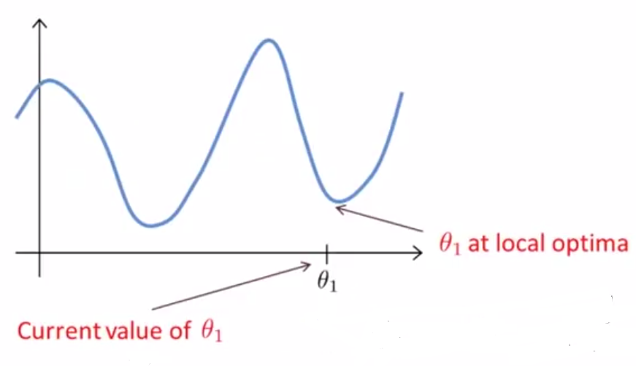
Question?
Hint: Slope

Slide 53
Time independent
Gradient Descent can converge to a local minimum, even with a fixed learning rate.
As we approach a local minimum, gradient descent will automatically take smaller steps. (as slope is also decreasing) So, no need to decrease alpha over time
(Show example)

Slide 54
Gradient Descent for Linear regression
Formula

Slide 55
Cost function for LR is always a bell function
Convex function
One global/local optima

Slide 56
Batch Gradient Descent
Each step of gradient descent uses all training examples

Slide 57
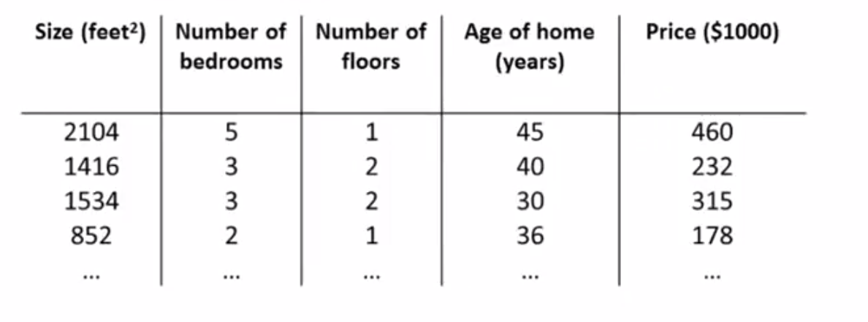
Multiple Linear Regression

Slide 58
Notation
k = number of features
x^{(i)} = input (features) of i^{th} training example
x_{j}^{(i)} = value of feature j in the i^{th} training example

Slide 59
Hypothesis of MLR
h(x) = cx₀ + m₁x₁ + m₂x₂ + m₃x₃ + m₄x₄
For convienence of notation lets say x₀ = 1
h(x) = m^{T}x

Slide 60
Gradient Descent for Multiple LR
Formula

Slide 61
Feature Scaling
Idea: Make sure features are on same scale
E.g. : x₁ =size (0-4000 feet²)
x₂ = number of bedrooms (1-5)
x₁ = size/4000
x₂ = number of bedrooms/5

Slide 62
Feature Scaling
Get every features approx. in range from -1<x_{i}<+1
Other accepted range of values.
Mean Normalisation
Replace x_{i} with x_{i}-u_{i} to make feature has approx. zero mean.
x₁ = size – 2000/4000
x₂ = #bedrooms – 2/5 -0.5<x_{i}<0.5
Standardization
We can also use standard deviation in denominator instead of range/max value

Slide 63
How to know if gradient descent is working correctly?
(show example)
Automatic convergence test:
declare convergence if J decreasesby less than 10⁻³ in one iteration.

Slide 64
If not working!
Use smaller alpha (show example)
For sufficiently small alpha, J should decrease on every iteration
But if alpha is too small, gradient can be slow to converge
If alpha is too large may not decrease on every iteration

Slide 65
What value of alpha should I choose?

Slide 66
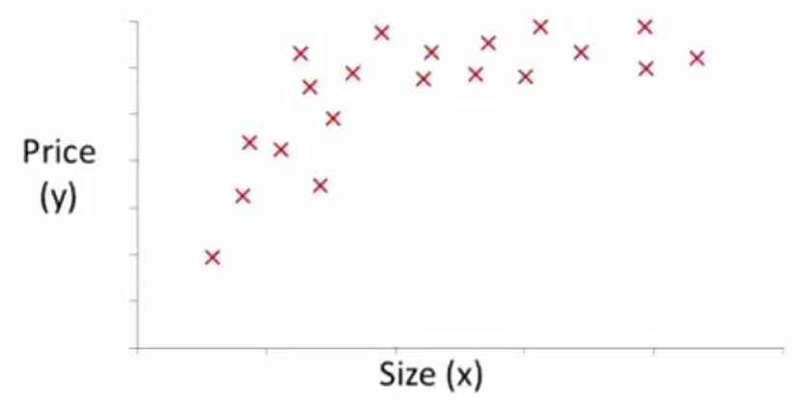
Polynomial Regression
m₁x + m₂x² + c
or
m₁x + m₂x² + m₃ x³ + c
In this case feature scaling is very important

Slide 67
Normal Equation
Method to solve for ‘m’ analytically
Instead of solving value of m iteratively we can solve the optimum value of m in one step.
m = (X^{T}X)⁻¹ X^{T}y

Slide 68
Gradient Descent
Need to choose alpha
Needs many iteration
Needs feature scaling
Works well even when
k(#features) is large
Normal Equation
No need to choose alpha
Don’t needs many iterate
No needs feature scaling
Need to compute (X^{T}X)⁻¹
(Slow if k is large) O(n³)
n < 10000

Slide 69
Assumptions
Linear relationship
Multivariate normality
No or little multicollinearity
Homoscedasticity

Slide 70
Problems With Linear Regression
Limited to Linear Relationships
Which can be overcome by using higher degree polynomial
Only Looks at the Mean of the Dependent Variable
e.g., babies are at risk when their weights are low, so you would want to look at the extremes in this example.
Sensitive to Outliers
Data Must Be Independent

Slide 71
Advantages
Very simple and easy to implement
Need less training data
No parameter tuning
As it is fast, it can be used in real time prediction
Performs well on new data which is not present in the training data

Slide 72


Applications in real world
Extensively used in all the businesses
Banking/Financial
domain
Retail Industry

Slide 73

Python code implementation
Jupyter Notebook

Slide 74

Discussion

Slide 75
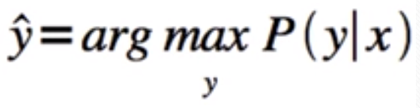
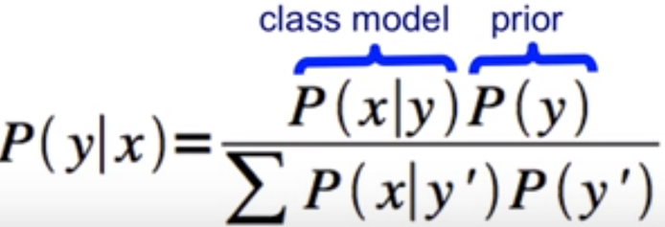
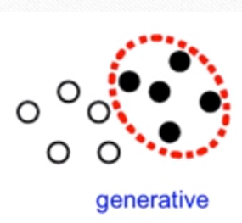
Recap – Naïve Bayes
Probabilistic Classifier
Most probable class given observation
Bayesian Probability of class:
Generative Model

Slide 76
Recap – Naïve Bayes
Assumption
Conditional Independence
Types of Naïve Bayes Models
Multinomial – frequency counts
Bernoulli – Binary features
Gaussian – Normally distributed features

Slide 77
Recap – Naïve Bayes
Problems with Naïve Bayes:
Not good in finding relationships if variance and mean is the same in the distribution
Zero frequency problem – Laplace Smoothing
Can fool NB by adding lot of hammy words in spam email – assuming independence
Advantages:
Need less training data
Handle both continuous and discrete data
As it is fast, it can be used in real time prediction
No requirement of fill in or explicitly model missing value

Slide 78
Recap – Naïve Bayes Code
from sklearn.naive_bayes import BernoulliNB, GaussianNB, MultinomialNB
Parameters: alpha : float, optional (default=1.0) Additive (Laplace/Lidstone) smoothing parameter (0 for no smoothing).
binarize : float or None, optional (default=0.0) Threshold for binarizing (mapping to booleans) of sample features. If None, input is presumed to already consist of binary vectors.
fit_prior : boolean, optional (default=True) Whether to learn class prior probabilities or not. If false, a uniform prior will be used.
class_prior : array-like, size=[n_classes,], optional (default=None) Prior probabilities of the classes. If specified the priors are not adjusted according to the data.
var_smoothing : float, optional (default=1e-9) Portion of the largest variance of all features that is added to variances for calculation stability.

Slide 79

Thank you!!!!!!

